Slide 1
ESSERC 2024 Presentation (A Template)
Name and Surname Department Name Institution Name, Country email@institute.com
Company logo’s are allowed (only) on this slide.

Slide 2
Outline
Text and Figures Template
Font sizes, bullets, sub-bullets
drawing line thicknesses, waveforms and graphs
Use of figures, colors
Fill this in in Slide master view

Slide 3
Slide Title Uses 32-Point Verdana
14 mil
Trace
0.7 mil
FR4 substrate
(ε_{r} = 4.5)
7 mil
Ground plane
1.4 mil
Keep figures on top of slides; bullets underneath
For main bullets, use 20-point Verdana: 24-point better
For sub-bullets, use 18-point Verdana: 20-point better
Do not use too many sub-bullets
Try your best to limit each bullet to one line
If a bullet becomes longer, break it into two bullets
If you are not planning to cover a bullet, do not include it

Slide 4
Figure Labels and Text
I(z,t)
I(z,t)
RΔz
LΔz
I(z+Δz,t)
V(z,t)
V(z,t)
GΔz
CΔz
V(z+Δz,t)
z
Z = R+jωL
, Y = G+jωC
Z₀ = (Z/Y)^{½}
γ = (ZY)^{½}
Use Verdana for figure labels and figure text
Keep the minimum font size in figures to 18
If needs be, make some labels in figures bold
Try to include a figure at least on every other slide

Slide 5
Drawing Lines
Y₂₈
Y₃₁
D Q
D Q
D Q
D Q
D Q
PRBS
CK
Use a minimum thickness of “2 ¼” in power point
A thinner line may not show up on screen

Slide 6
Use of Solder Dots
OUT
IN
IN
OUT
V_{RN}
V_{RP}
V_{B2}
V_{B1}
1st stage transconductance
2nd stage
transimpedance
Use solder dots to avoid connection ambiguity
* Y. Tomita et al., JSSC, Apr. 2005, pp. 986-993

Slide 7
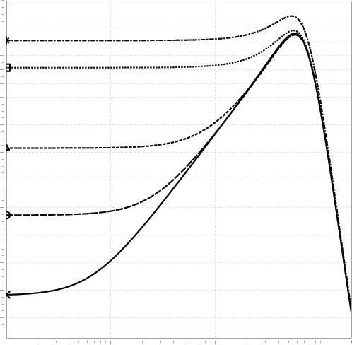
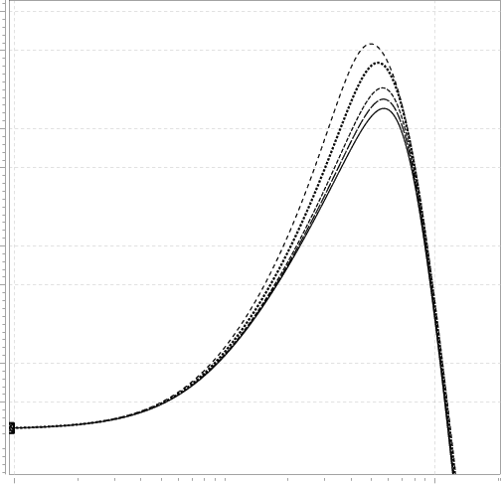
Waveforms and Graphs
(V_{RP}=0V)
(V_{RN}=0.8V)
20
V_{RN} =1V
V_{RP}=0.45V
20
0.4V
0.3V
0.9V
40dB/dec
0.2V
0.8V
0V
0
Gain [dB]
Gain [dB]
10
0.75V
20dB/dec
0.7V
-20
0
0.01
0.1
1
10
0.1
1
10
GHz
GHz
Results should be readable (min. font size 18)
Do NOT simply import from Cadence viewing tool

Slide 8
Use of Colors: Use RGB
PMOS switch
Strong-ARM latch
CML latch
CK
OUT
IN
OUT
IN
IN
OUT
IN
IN
IN
CK
CK
Bias
CK
s(t)
0
Time

Slide 9
Equations
φ_{VCO}
φ_{e}
φ_{OUT}
φ_{in}
K_{pd}
H_{LPF}(s)
K_{VCO}/s
Jitter Transfer
Jitter Generation
Use font size similar to those in figures

Slide 10
More on Using Colors
φ_{VCO}
φ_{e}
φ_{OUT}
φ_{in}
K_{pd}
H_{LPF}(s)
K_{VCO}/s
Jitter Transfer
Jitter Generation
φ_{OUT} / φ_{in}
φ_{OUT} / φ_{VCO}
dB
Jitter Freq.
f_{corner}
Use colors as necessary, but not more

